Slide 1
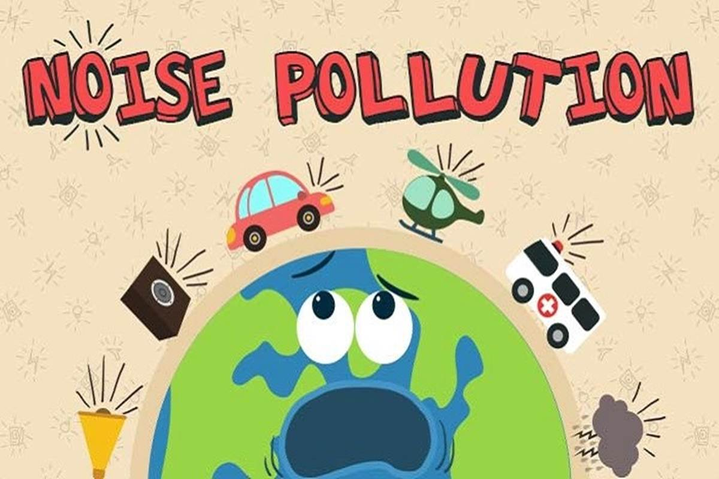


Noise Pollution Study
Intersection near Mego Store inRezekne, Latvia

Slide 2
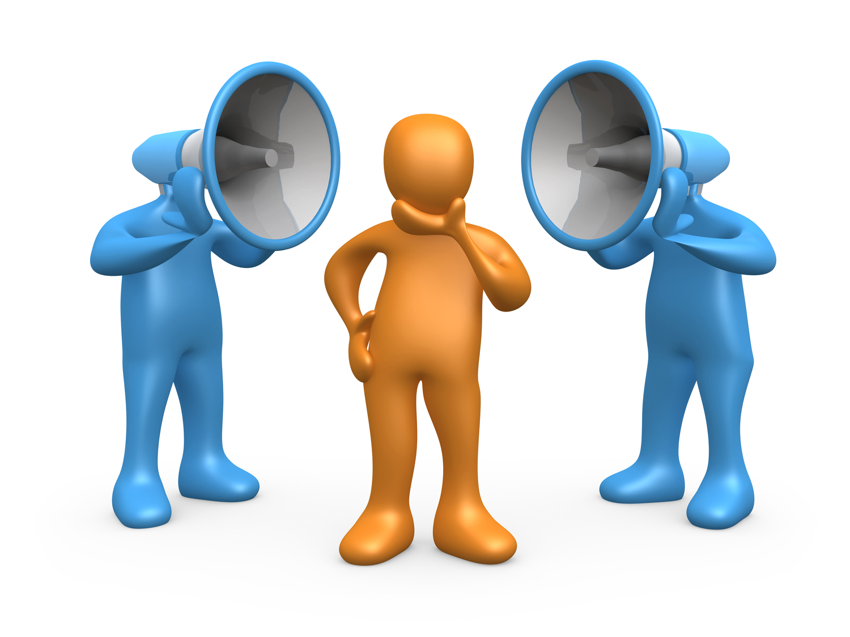
Research Aim
Measure noise pollution in a city location
Analyze causes of noise
Understand impact on people and environment

Slide 3
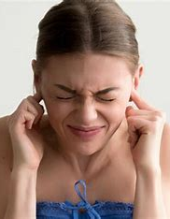
Causes of Noise Pollution
Traffic and cars
Supermarkets and shops
Factories and urban activity
Large numbers of people

Slide 4
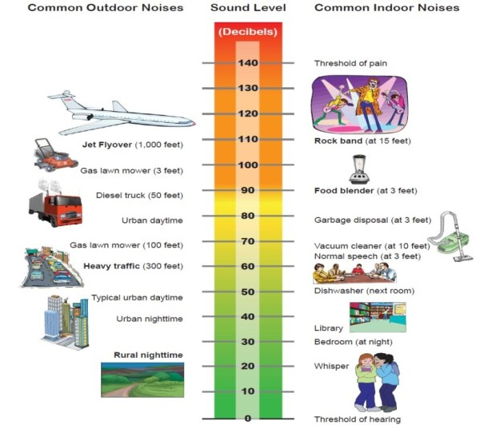
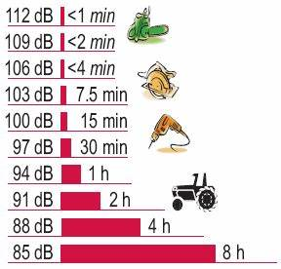
Effects of Noise Pollution
Hearing problems
Stress and fatigue
Communication difficulties
Headaches and high blood pressure

Slide 5
Noise Measurement Results
The acceptable noise level is considered to be sound that does not exceed:
55 decibels (dB) during the daytime (7:00–23:00)
45 decibels (dB) during the night (23:00–7:00)
It is generally believed that 60 dB is the comfort limit for humans.

Slide 6
Effects of Noise Pollution
Socioacoustic effects
Minor damage to the hearing system, often causing ringing in the ears after exposure to loud noise.
Communication problems
When noise levels are high, verbal communication becomes more difficult.
Physical effects
Exposure to loud noise can cause physiological reactions such as:
pupil dilation
increased heart rate and pulse
higher blood pressure
headaches
Psychological effects
Noise can negatively affect mental and emotional health, causing:
insomnia
fatigue
stress
depression
anxiety
irritability

Slide 7
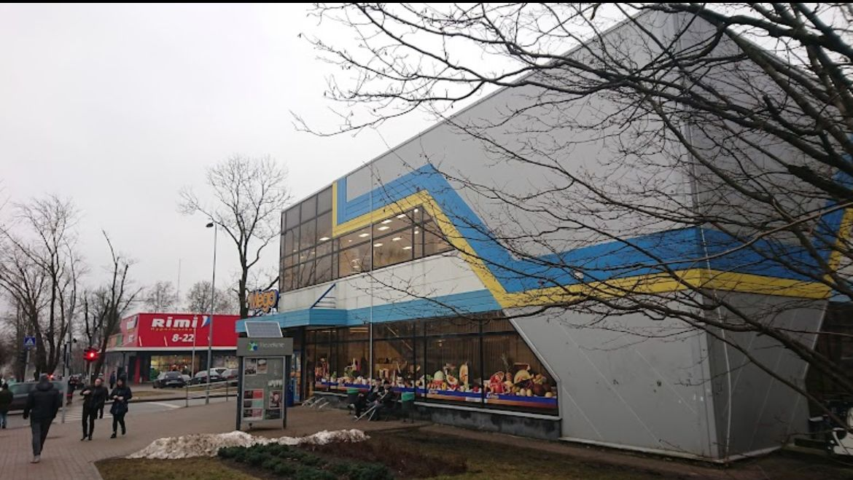
Research Location
The research was conducted at the intersection near the Mego store in Rezekne.

Slide 8
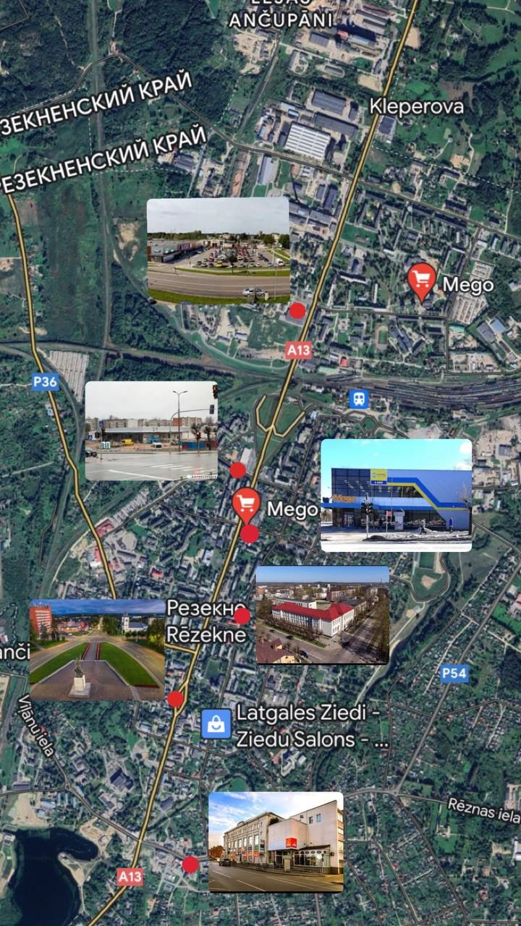
A map

Slide 9
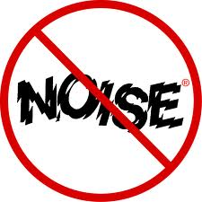
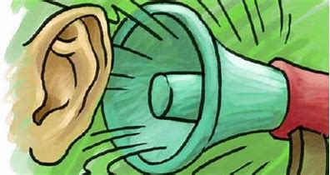
Results Analysis
The data shows that noise pollution near the Mego store is relatively high throughout the day.
This can be explained by the large number of cars and people moving through the area.
Noise levels at both measurement times were similar, but the noise level at 20:00 was slightly higher, likely because people return home from work or activities and visit shops during the evening hours.

Slide 10
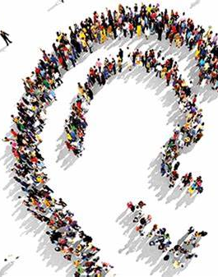
Conclusions
The results show that the noise pollution level at this location is quite high.
Because of this, people may feel uncomfortable staying near the Mego intersection for long periods. High noise levels may cause:
anxiety
discomfort
irritation
minor hearing damage
fatigue
headaches
increased heart rate

Slide 11

Additional Conclusions
To reduce noise pollution near the Mego store, the city could implement measures such as:
reducing car traffic during the evening
limiting store working hours to decrease traffic and pedestrian flow
All research tasks were completed successfully. Noise pollution was measured, results were analyzed, and conclusions were drawn. The research process went smoothly without significant problems.

Slide 12

Thank you for attention!

