Slide 1
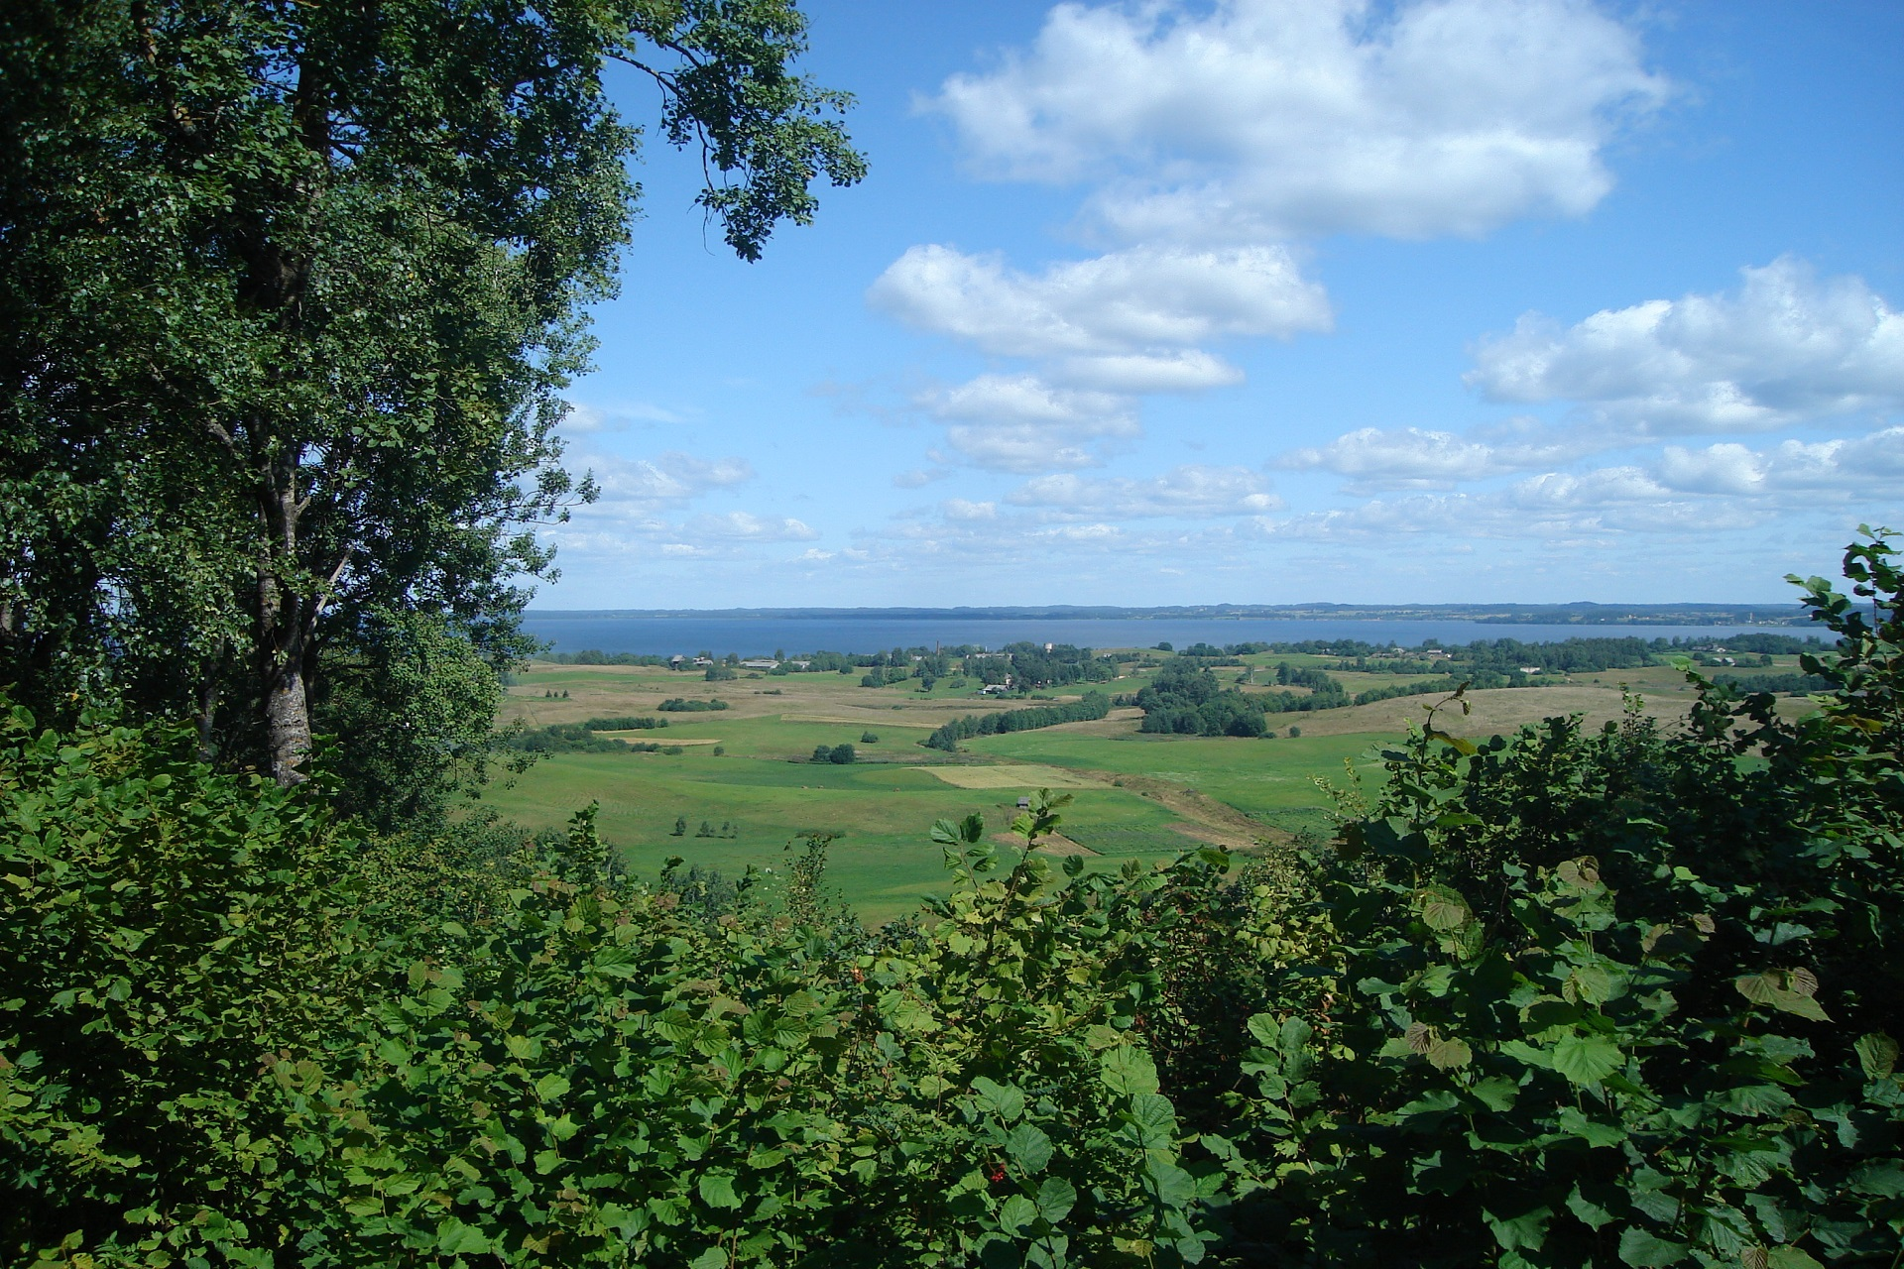
Rāzna National Park

Slide 2
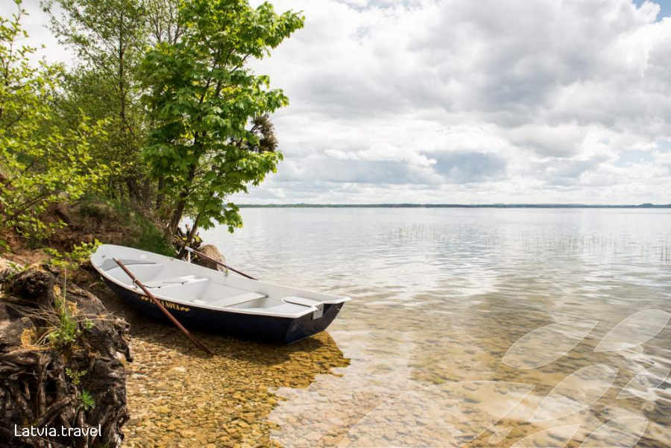
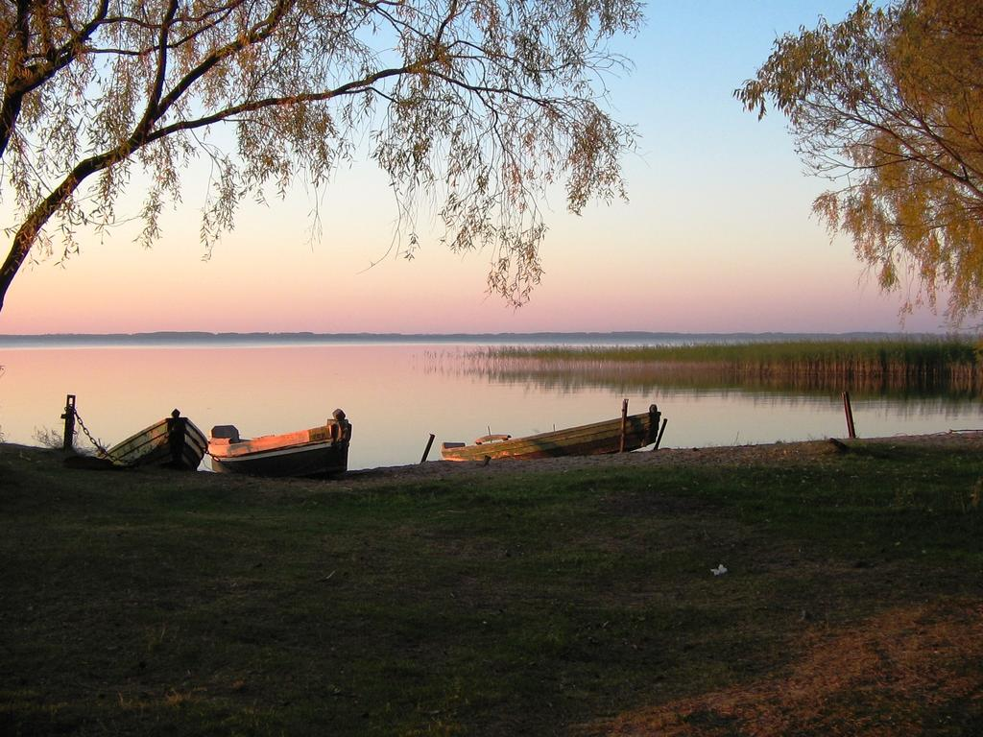
What is rāzna national park
Rāzna national park is one of the 4 national parks in Latvia, however it isn’t the biggest.
It consists of many lakes, as well as the biggest lake by volume- Rāzna lake.
The national park was established 15 years ago.

Slide 3
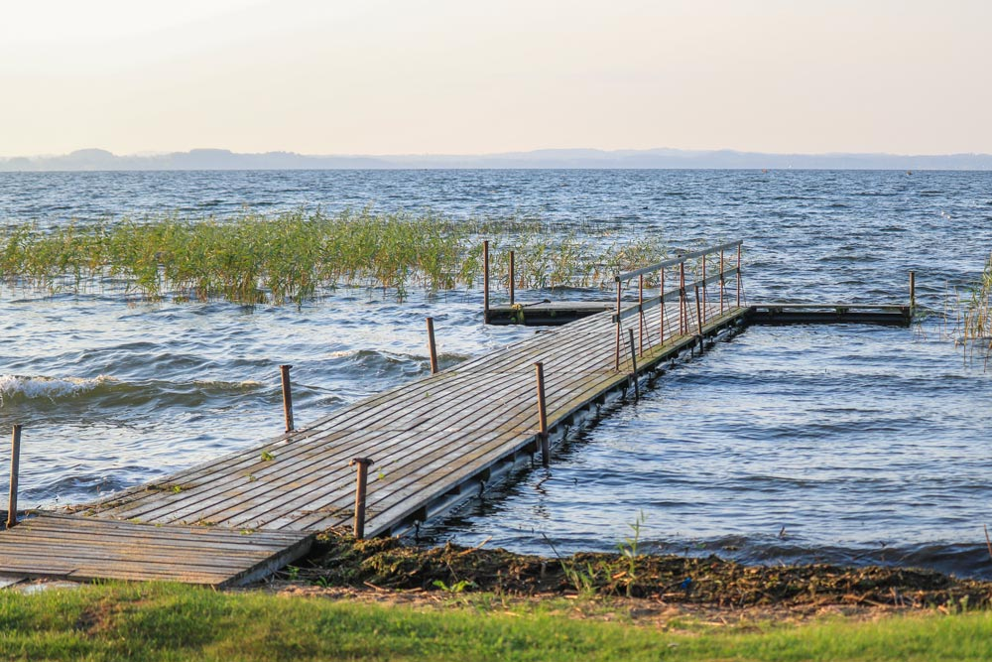
Establishment
In 1999 funds were allocated for a project to create a nature park based on the lake.
In 2001, the local governments proposed this idea.
In 2004, the official establishment of Rāzna National Park takes place.

Slide 4
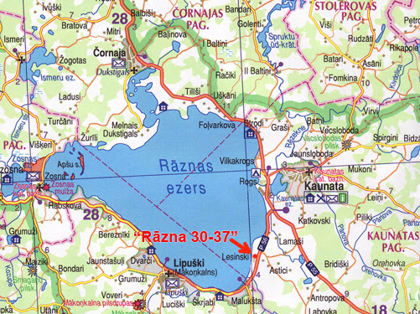
Geography
Rāzna National Park is located in the central part of Latgale upland.
The National Park occupies an area of 59615 hectares.
The average depth of the lake is approximately 7m, but the maximum depth reaches 17m.
There are 10 islands on the lake.

Slide 5
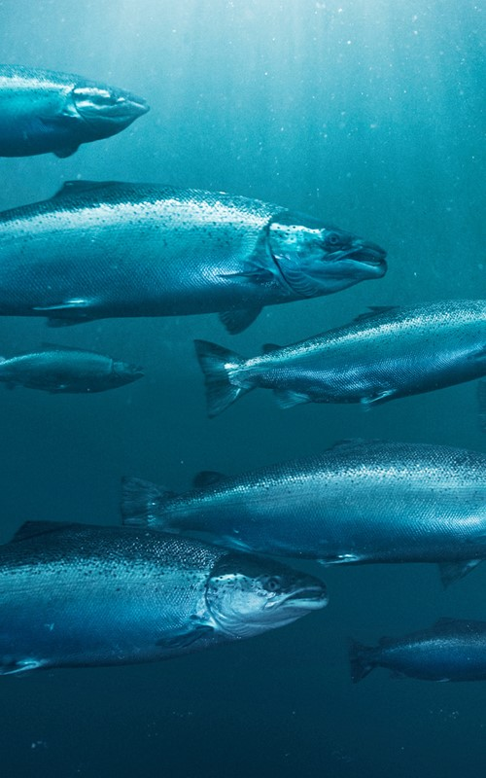
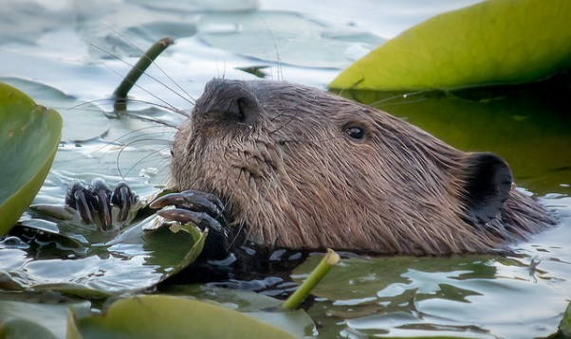
Wildlife
27 species of fish inhabit Lake Rāzna, almost 90% of the fish species found in Latvian lakes.
Lake Rāzna provides good conditions for species of all sorts of fish and other land animals.
Wide variety of bird, beaver and other amphibian species.

Slide 6
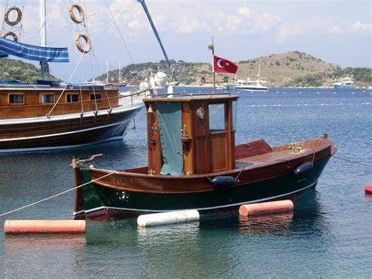
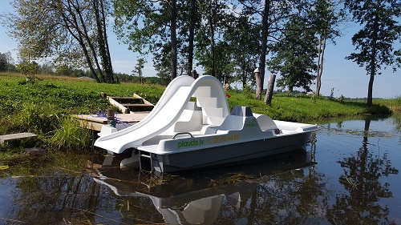
cruise
Cruise is a small trip around any kind of water.
It is possible to make mini–crusises with the boat or with the ships around the lake.

Slide 7
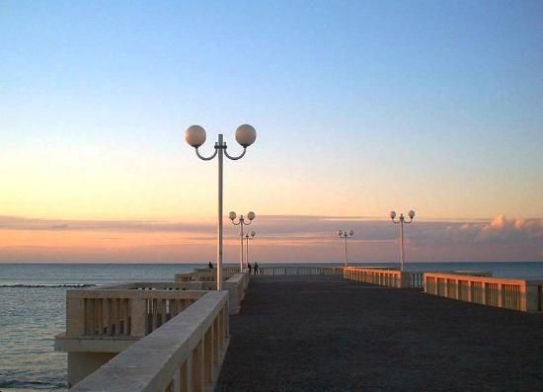
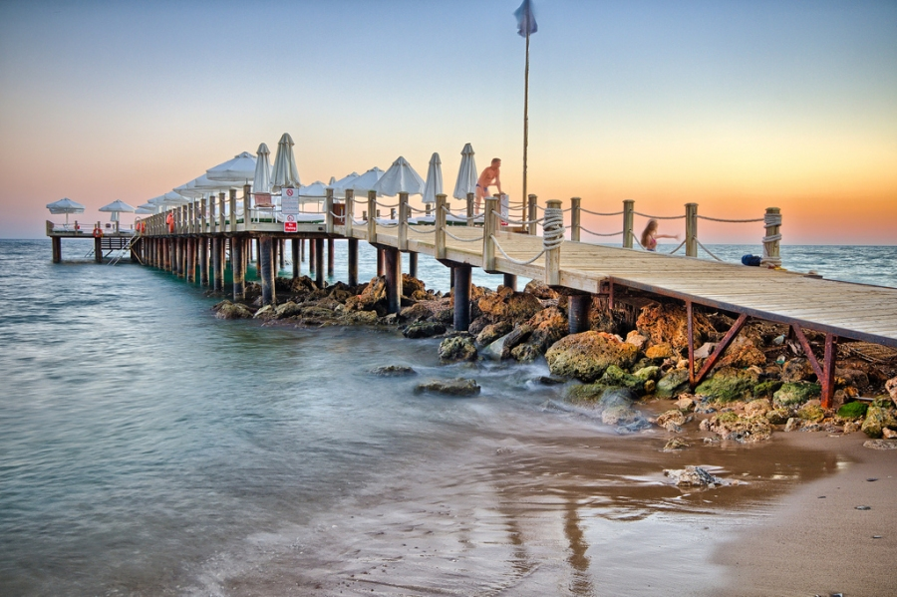
Pier
A perfect place for sightseeing, taking photos, and enjoying your time.
Main idea- repair and renovate the pier. For example, increase its size, make it more stable so it can support more weight.

Slide 8
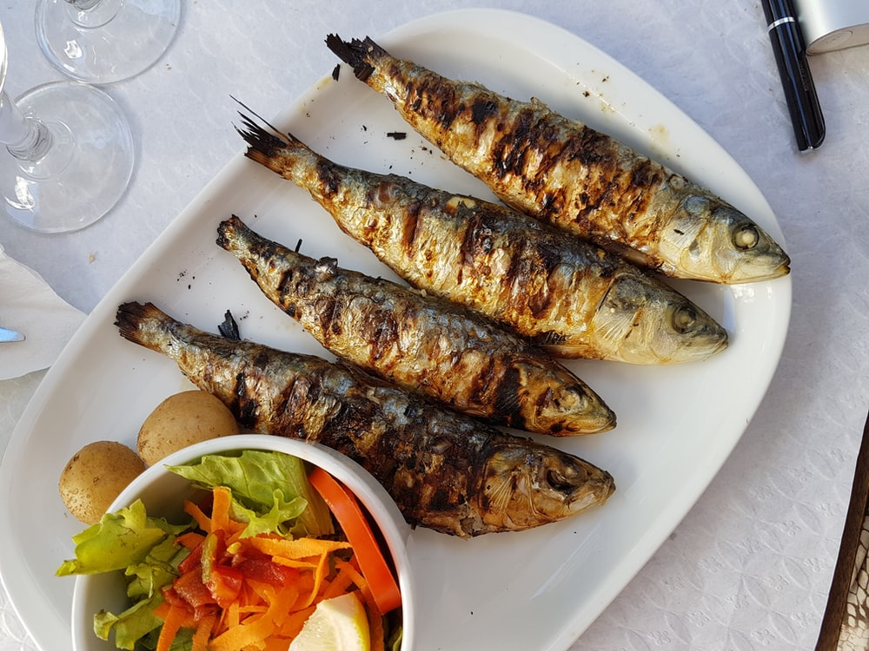
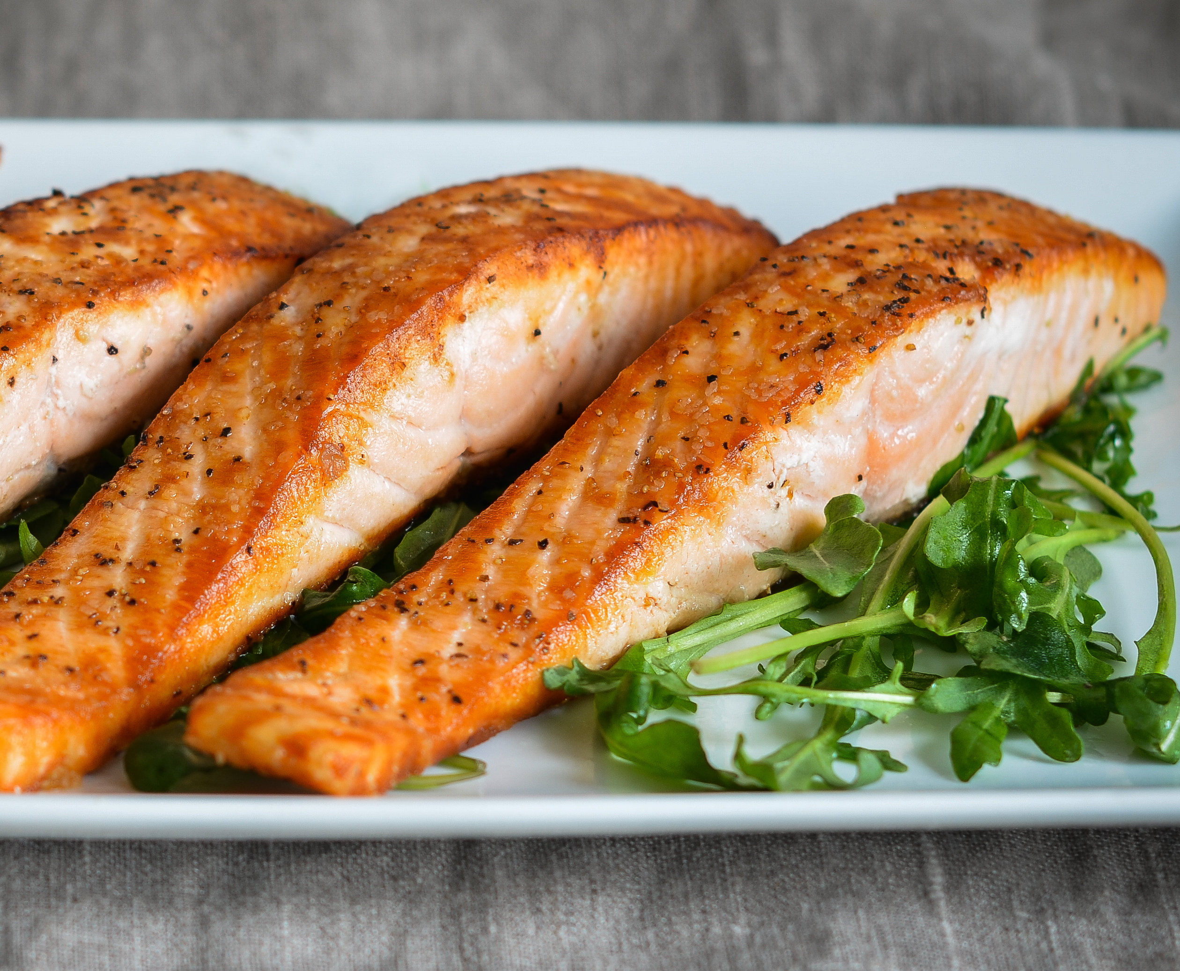
RESTAURANT
For those who come here it could be great to eat something while enjoying the view. So it would be great to develop a restaurant which is open mornings and evenings.
In addition to that provide a menu which consists mostly of seafood.

Slide 9
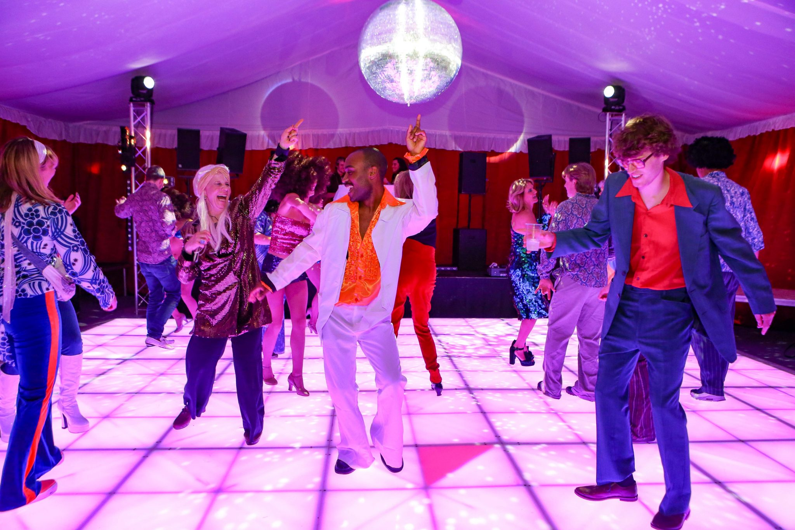
Entertainment
For entertainment proposing an idea of adding concerts, plays or simple parties for everyone.
Pathways for hiking, riding on rented bikes.
Guesthouses for individual purposes.
Bigger shores/ beaches.
Build a basketball court, set up a volleyball net.

Slide 10
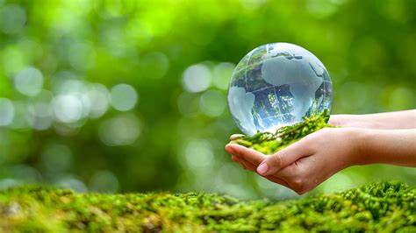
Environment protection
International signs which point to the direction of certain areas.
Trash bins next to benches, so people don’t litter.
Volunteering for labour days to clean the shores of lake Rāzna.

Slide 11
BUDGET
Government subsidized projects for events and buildings
Donations for projects

Slide 12
OUR EXPERIENCE WORKING TOGETHER
It was very fun working together, yet it was quite exhausting
I feel so lucky to be here. It is very good experience.
I was bored because the lake wasn’t very impressive.

Slide 13
THANKS FOR WATCHING!
Any questions?

