Slide 1
Luznava Manor

Slide 2
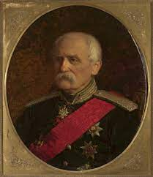
Short Informations
Lūznava Manor is a manor house located in the village of Lūznava, Rēzekne Municipality, Latvia. Today the local primary school of Lūznava is located in the manor house.
Lūznava Manor was built between the years 1905–1911. The owner of the manor was the engineer Stanisław Kierbedź and the architect is unknown and is characterized by historicism and Art Nouveau.

Slide 4
How Can We Enhance This Fantastic Construction?

Slide 5
Tea Tasting
A day full of relaxation, drinking a hot tea, surrounded by nature, can be a fantastic way to attract tourists.

Slide 6
Traditional Food Tasting
Definitely taste some small portions of typical food would be nice.

Slide 7
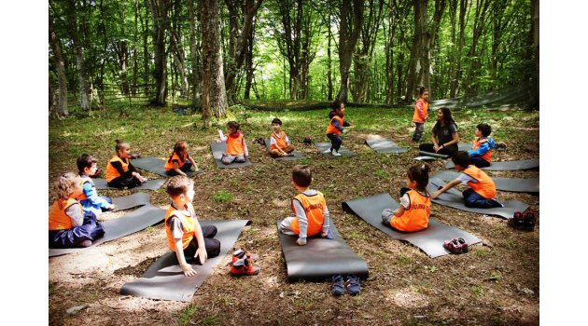
Sport Events

Slide 8
Signs Near Trees or Leaves With Their Names
It would be nice and fun to add signs in English near particular trees or leaves, to make everyone understand their name or their characteristics

Slide 9
Organizations Of concerts or Dance Festivals

Slide 10
Thanks For Listening

